Slide 1

La Miga Bakery

Slide 2
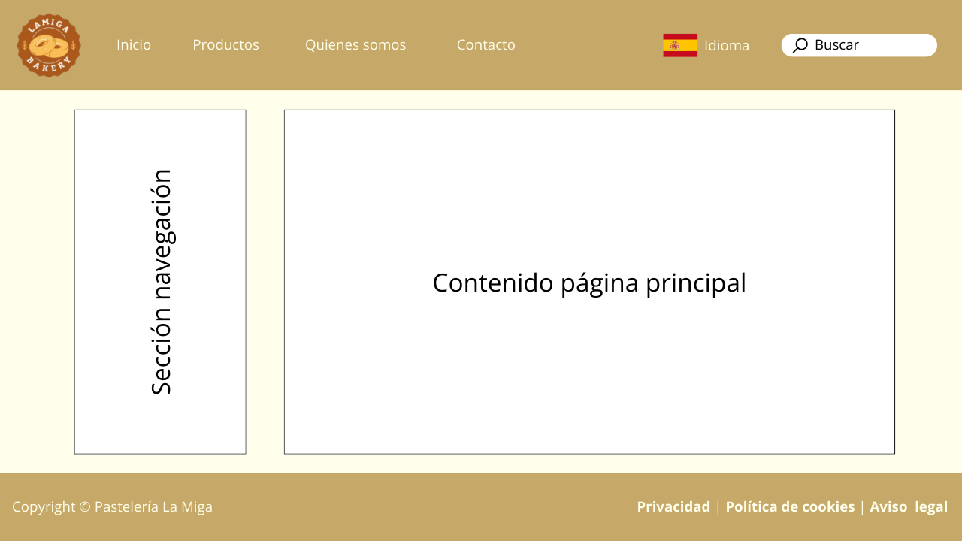

Slide 3
